Slide 1
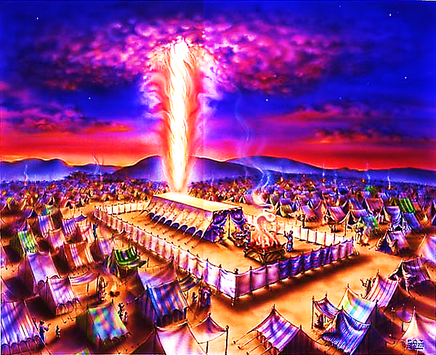
The Tabernacle in the Wilderness pt. 9

Slide 2
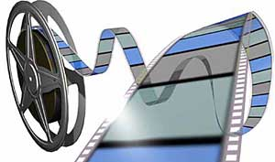
Note: Any videos in this presentation will only play online. After you download the slideshow, you will need to also download the videos from YouTube & add them back into your PowerPoint.
We present these messages at Bee Creek Park in College Station, TX. If you would like to watch the video of the service with this message, click here:
http://campaignkerusso.org
We would love to know more about the people who download our lessons & sermons. We invite you to email us & let us know where & how you use them.
info@ckbrazos.org

Slide 3
Everything About the Tabernacle Points to Jesus

Slide 4
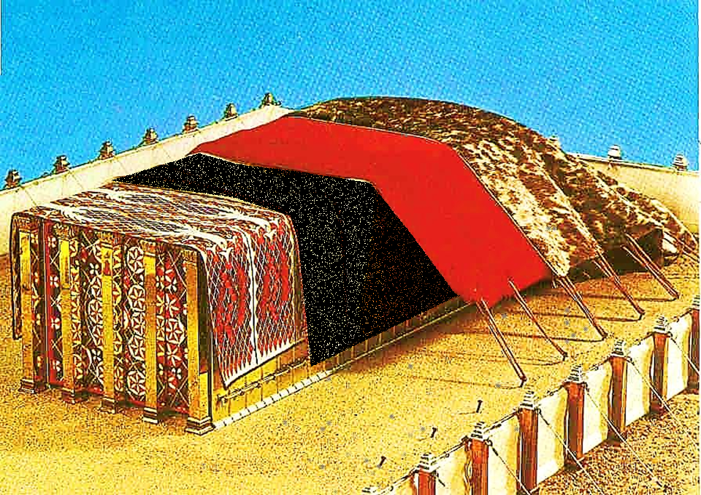
Today, we will look at the next covering.
Our Divine
Christ

Slide 5
Next, we will look at the next covering.
Our Sin Offering
Our Divine
Christ

Slide 6
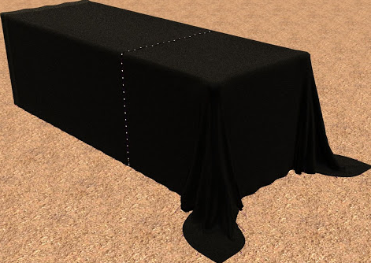
This is a picture of the Lord Jesus taking our sin upon Himself.
This covering completely covered the beautiful covering beneath it.
Man’s Sin & Failure
“Christ never sinned but God put our sin on Him...” 2 Cor. 5:21
Our sin covered
Jesus on the cross.

Slide 7
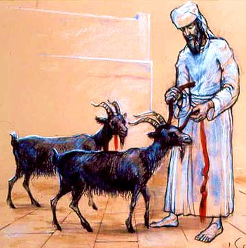
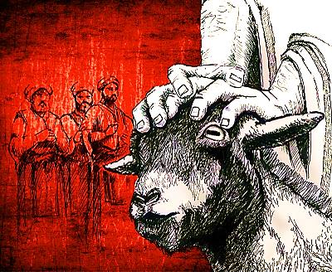
The ‘SCAPEGOAT’ was an innocent goat that the High Priest laid hands upon & confessed the nation’s sins. It was then sent out of the camp.
The ‘SIN OFFERING’ was an innocent goat that died for one year’s worth of the nation’s sins.

Slide 8
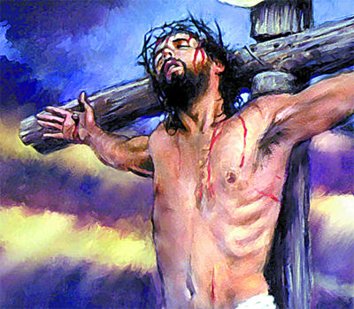
“…sending His own Son in flesh like ours… as a sin offering” Rom. 8:3
Jesus is Our Sin Offering Who
Died for Our Sins – not just for one year, but Forever!
Jesus is Our SCAPEGOAT
“He has removed our sins as far from us as the east is from the west.” Psalm 103:12

Slide 9
Now, we will look at the next glorious covering.
Our Sin Offering
Our Divine
Christ

Slide 10
Now, we will look at the next glorious covering.
Our Redeemer
Our Sin Offering
Our Divine
Christ

Slide 11
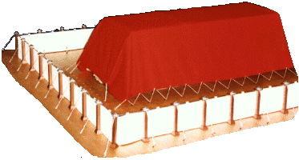
Ram’s Skin Dyed Red

Slide 12
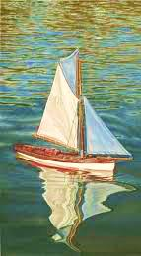
The Boy’s Boat
A young man who lovingly built a little sailboat. Having finished it, he took it to a stream behind his house and put it in the water. The little boat sailed perfectly! But the wind blew hard and his boat was taken away and he could not find it. After he searched for a long time he sadly returned home.

Slide 13
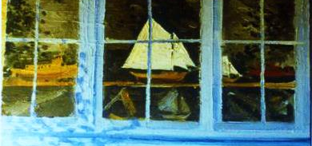
One day he was walking downtown and saw his boat in a store window. Having found out from the store-owner how much the boat would cost he returned home and got all the money he had.

Slide 14
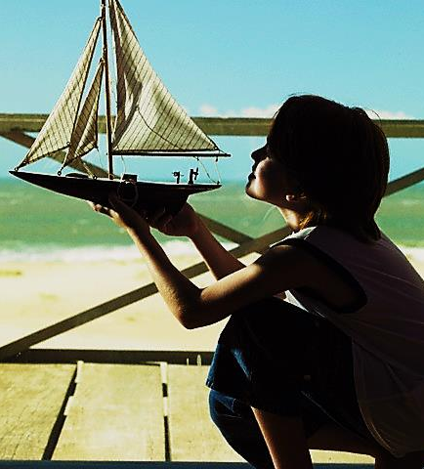
After paying for the boat, he was walking home and said to his boat, “you are twice mine, I made you and I bought you”.

Slide 15
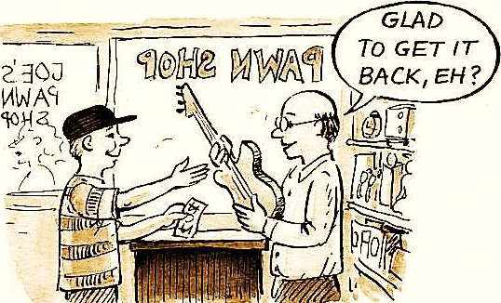
What is a Redeemer?
A redeemer is someone who buys back something (or someone) that got lost.

Slide 16
New
Redeem:
To pay the price or debt for something that was lost.

Slide 17
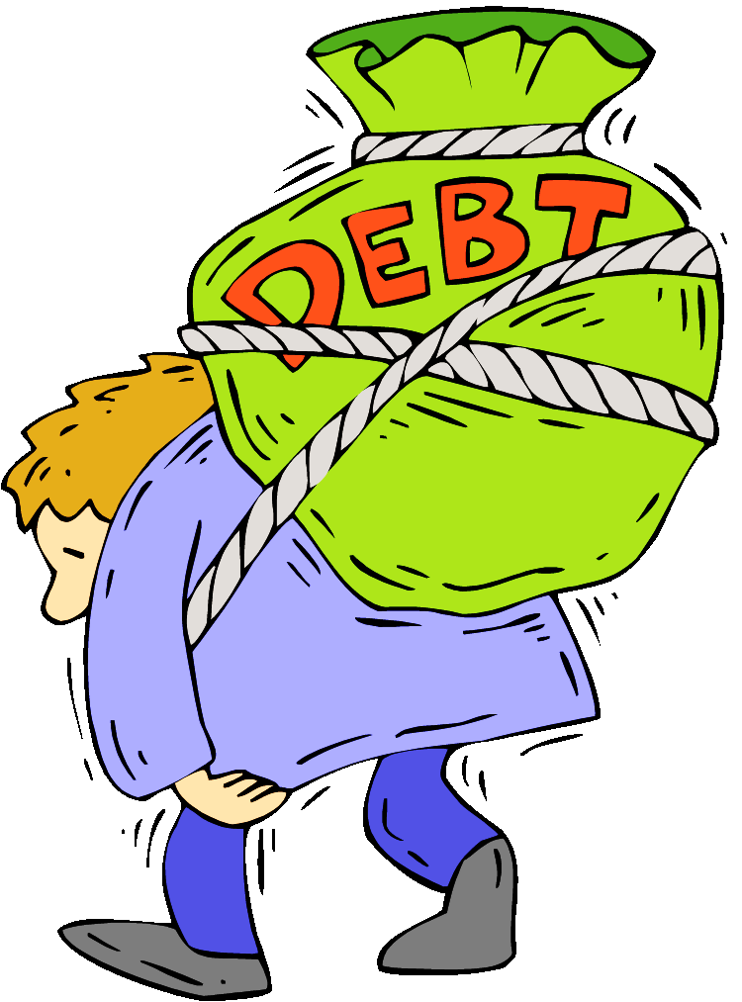
We are the one’s who got lost. We sinned!
“The person who sins will die.” Ezek. 18:20
This is the sinner’s debt.
We need a REDEEMER (Redeemer is someone who buys back someone who got lost) → We need someone willing and able to pay the price for our sin.

Slide 18
Blood Must be Shed…
…either the blood of the person who sinned or the blood of an innocent substitute.

Slide 20
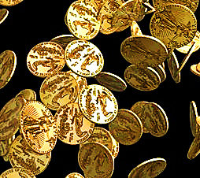
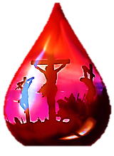
"…you were not bought with things that can pass away, like silver or gold…. Instead, you were bought by the priceless blood of Christ. He is a perfect lamb. He doesn’t have any flaws at all.” Pet. 1:18-19

Slide 22
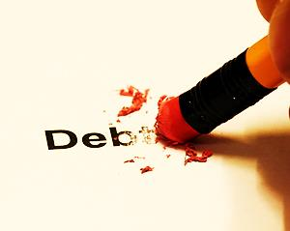

Slide 23
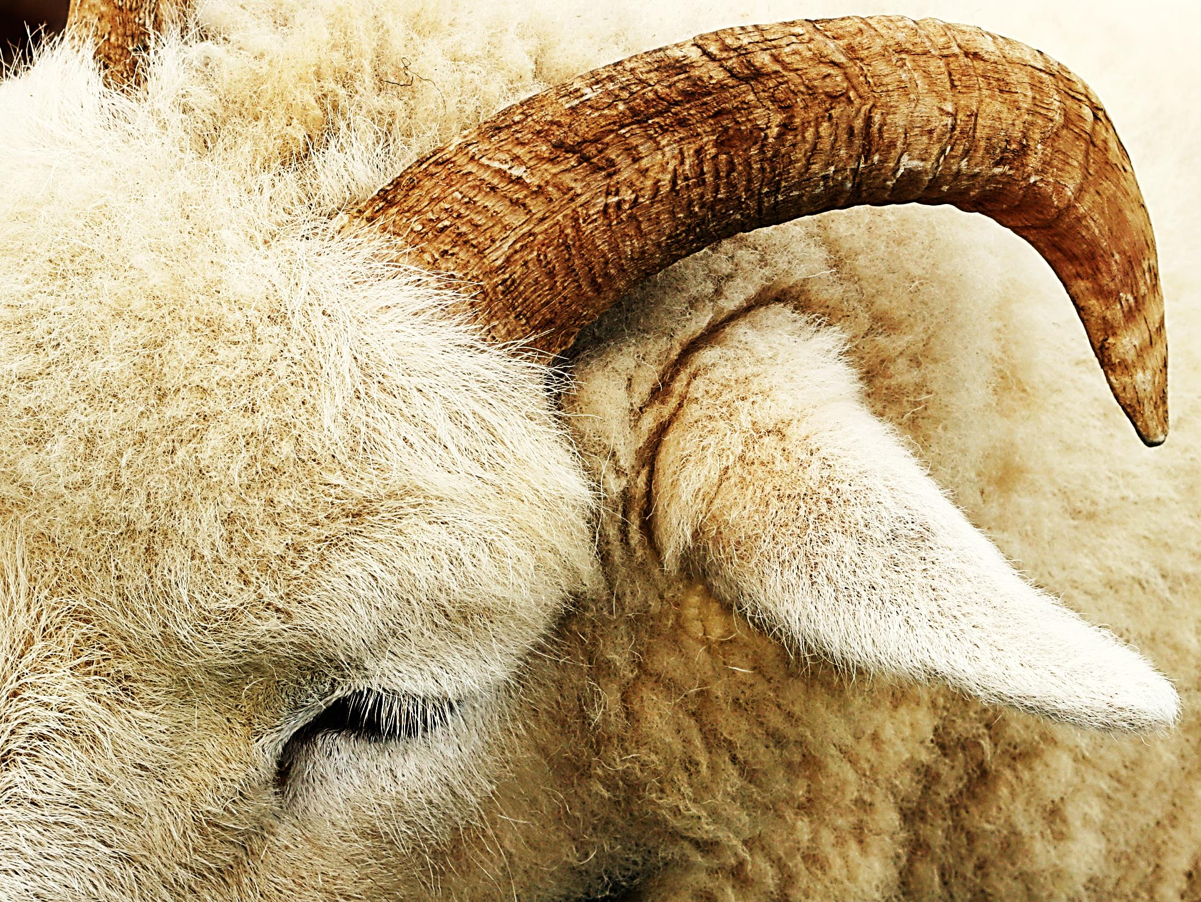
The Ram (male sheep) was killed as a substitute for Israel’s sins.

Slide 24
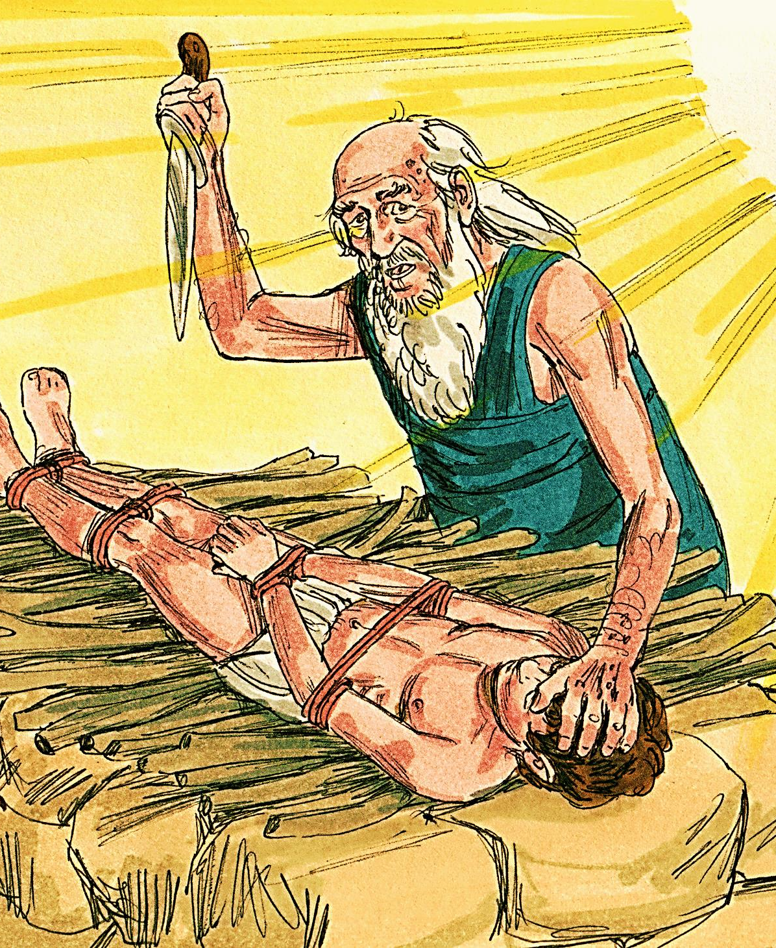
“Isaac said, ‘We have the fire and the wood, but where is the lamb we will burn as a sacrifice? Abraham answered, ‘God will give us the lamb for the sacrifice, my son.’” Gen. 22:7, 8

Slide 25
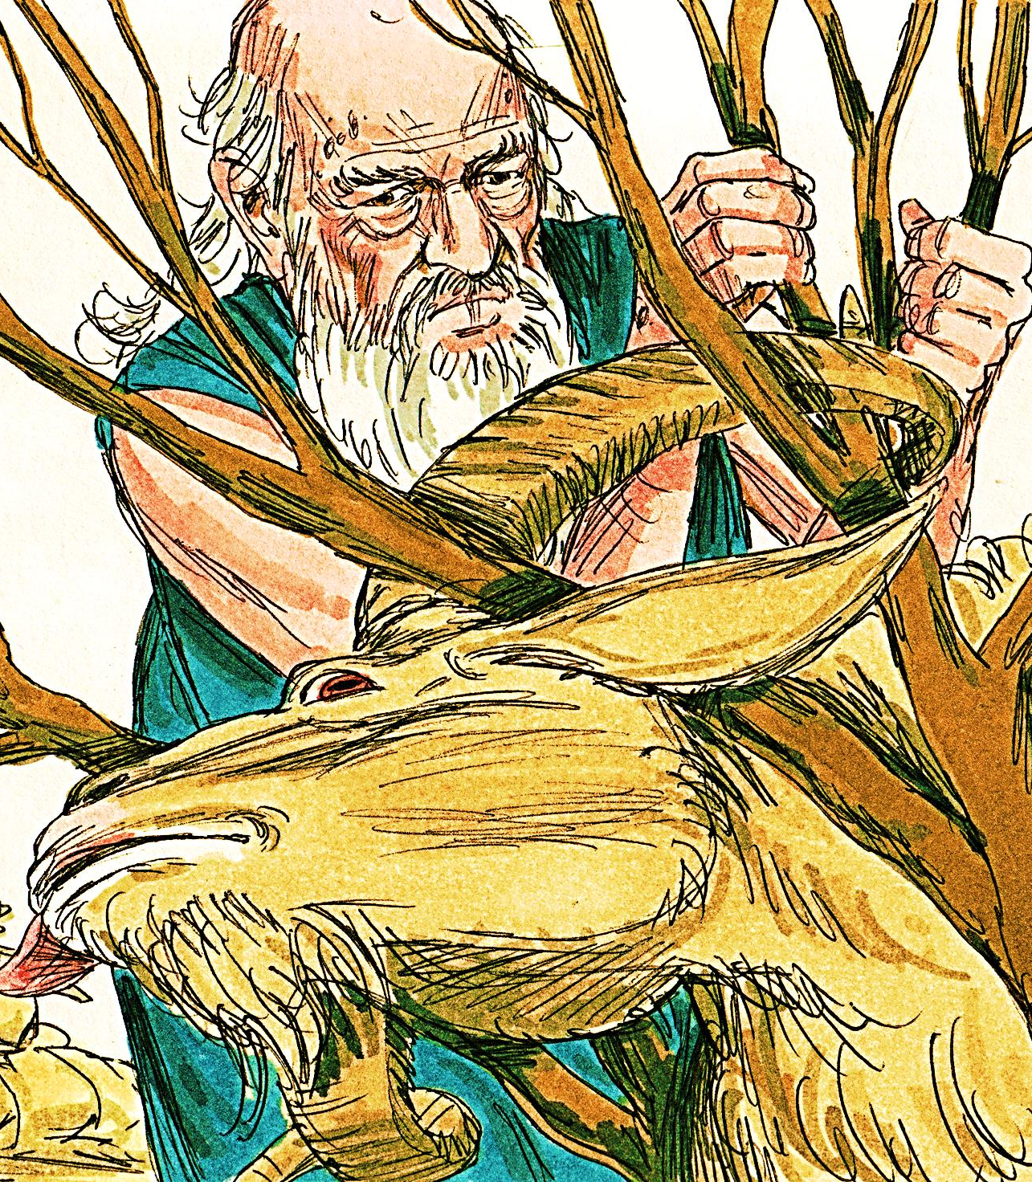
“Abraham looked up and there in a thicket he saw a ram caught by its horns. He went over and took the ram and sacrificed it as a burnt offering instead of his son.”
Gen. 22:13

Slide 26
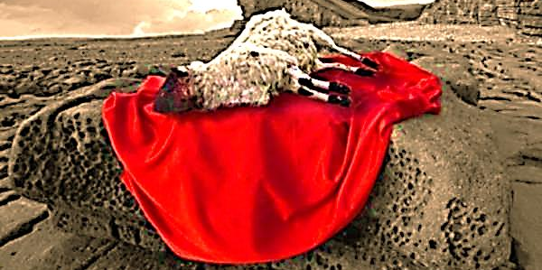
The Ram wasn’t born with red skin, it was dyed red.
“Without the spilling of blood, no one can be forgiven.” Heb. 9:22

Slide 27
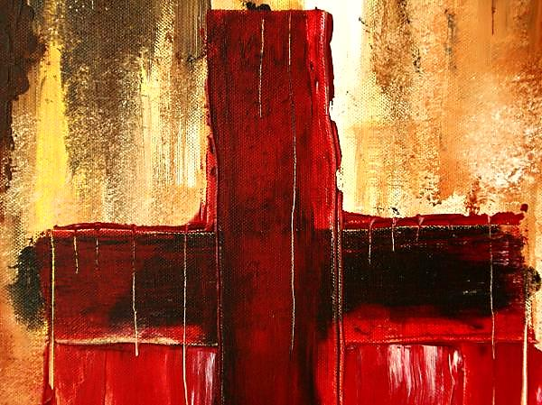
If Jesus had not shed His blood to pay our debt, we would still have to die for our own sins.
“God will provide Himself a Ram” → We are Isaac & Jesus is the ram in the thicket.

Slide 28
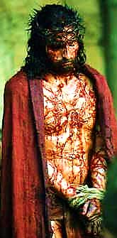
Jesus Laid Down His Life
"Men were cruel to him, but he was gentle and quiet; as a lamb taken to its death…”
Isa. 53:7
“No one takes my life from me. I give my life of my own free will.”
John 10:18

Slide 29
The Ram Skin Covers Our Sins
Our Redeemer
Our Sin Offering
Our Divine
Christ

Slide 30
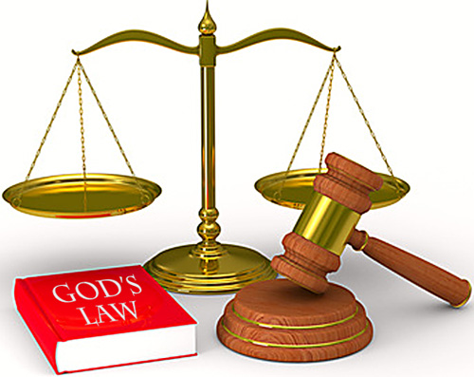
Our Sins are Huge & they are Measured by God
“…you've been weighed on the scales, and you don't measure up.”
Dan. 5:27

Slide 31
The Sin Offering Cover (goat’s hair) was an exact measured size.
Man’s Sin & Failure
This Red Cover Had NO Measure!
No Limit!
Our Redeemer

Slide 32
God’s forgiveness & Love are Unmeasured
"This is my blood… It will be poured out, so that MANY people will have their sins forgiven." Mat. 26:28
“For by the blood of Christ… our sins are forgiven. How GREAT is the grace of God!!”
Eph. 1:7

Slide 33
“… and the blood of Jesus his Son…
s
…makes us clean from ALL sin.” 1 John 1:7

Slide 34
What is the Sinner‘s Prayer?
This is a prayer we can pray when we are ready to admit we are sinners and need Christ’s forgiveness.
It must be prayed with faith in our hearts and a readiness to have a life-changing encounter with Jesus Christ.

Slide 36
John Wesley’s Testimony
“…the preacher was describing the change which God works in the heart through faith in Christ and I felt my heart strangely warmed.”
Disciple’s Testimony
“They said to each other, ‘Did not our hearts burn within us while he talked to us on the road, while he opened to us the Scriptures?’”

Slide 37
A prayer of faith → Pray this prayer if :
If you never have before
You have in the past, but you think it would mean more today
You have been walking afar off and you want to come back
You want to set an example & show others how it is done
You just like to give your heart to Jesus again & again
Faith

Slide 38
We Declare Our Faith Publicly Because Jesus Declared His LOVE Publicly
“If you stand before others and are willing to say you believe in me, then I will tell my Father in heaven that you belong to me.” Mat 10:32

Slide 39
Dear Jesus,
I know I am a sinner & need your forgiveness.
I believe you died for my sins.
I now turn from sin.
Come into my heart I pray.
Do you want to meet Jesus as your savior right now?
Do you believe He died to save you from your sins & that He rose from the dead?
Do you believe that He is waiting to save you right now?

Slide 40
“But some people did accept him. They believed in him, and he gave them the right to become children of God.” John 1:12

Slide 42
“If you openly say, ‘Jesus is Lord’ and believe in your heart that God raised him from death, you will be saved.”
Rom. 10:9
What did you learn today?
What is the meaning of the name-tag?
What have you neen thinking about God lately?
What do you want to tell the world about Jesus?

Slide 43
“Draw near to God, and He will draw near to you…
…Cleanse your hands, you sinners, and make your hearts pure, you who are half-hearted towards God.” James 4:8 WNT

Slide 44
Close in Prayer

Slide 45
Note: Any videos in this presentation will only play online. After you download the slideshow, you will need to also download the videos from YouTube & add them back into your PowerPoint.
We present these messages at Bee Creek Park in College Station, TX. If you would like to watch the video of the service with this message, click here:
http://campaignkerusso.org
We would love to know more about the people who download our lessons & sermons. We invite you to email us & let us know where & how you use them.
info@ckbrazos.org

Slide 46
Welcome to Aggieland Faith Family Style Worship

Slide 47
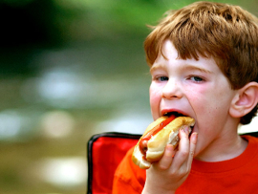
CURRENT SCHEDULE: See www.Aggielandfaith.org
SATURDAY —
At Bee Creek Park
2:00-4:00pm: Through the bible with felt-board stories – plus hot-dogs & drinks
SUNDAY —
At Bee Creek Park
2:00-4pm: Free snacks, drinks, kids crafts, prizes, singing & bible preaching

Slide 48
Would You Like Prayer or Bible Study at Your House?
Personal Prayer: We can come to your home & pray with you, or you can email us when you need prayer.
Home Bible Study: We will come to your home & hold a bible study for you & your friends.
Bible Party: We will hold a Kid’s Bible Party: You provide the food & kids - we will do the bible fun & stories.

Slide 49
Would You Like Visitation?
We will visit a friend, loved one in the hospital or in prison to pray for them & share Christ with them.
Contact: info@aggielandfaith.org

Slide 50
www.aggielandfaith.org
Go here to see pictures & videos
Go here to subscribe to e-mails about changes & cancellations

Slide 51
Note: Any videos in this presentation will only play online. After you download the slideshow, you will need to also download the videos from YouTube & add them back into your PowerPoint.
We present these messages at Bee Creek Park in College Station, TX. If you would like to watch the video of the service with this message, click here:
http://campaignkerusso.org
We would love to know more about the people who download our lessons & sermons. We invite you to email us & let us know where & how you use them.
info@ckbrazos.org

